Slide 1
Power management and Sleep modes
Sleep modes enable the application to shut down unused modules in the MCU
Hence useful for saving Power .
AVR Provides six sleep modes.

Slide 2

MCU Control Register– MCUCR
To enter any of the six sleep modes, the SE bit in MCUCR must be written to logic one after that .
SLEEP instruction must be executed
MODES:
  Idle
  ADC Noise Reduction
  Power-down
  Power-save
  Standby
  Extended Standby

Slide 3
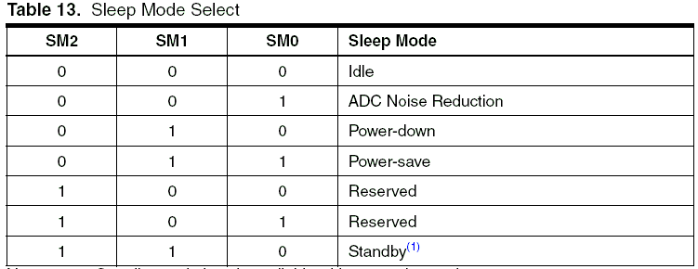
cont...

Slide 4
Idle Mode
SM2..0 bits are written to 000
Stop the CPU
SPI, USART, Analog Comparator, ADC, Two-wire Serial Interface, Timer/Counters, Watchdog, and the interrupt system to continue operating.
This sleep mode basically halts clkCPU and clkFLASH, while allowing the other clocks to run.
Wakes up : external triggered interrupts as well as internal ones

Slide 5
ADC Noise
Reduction Mode
SM2..0 bits are written to 001
Stop the CPU
ADC, External Interrupts, Two-wire Serial Interface address watch, Timer/Counter0 and the Watchdog continue to work operating (if enabled).
This sleep mode basically halts clkI/O, clkCPU, and clkFLASH, while allowing the other clocks to run.

Slide 6
Power-down Mode
SM2..0 bits are written to 010
External Oscillator is stopped
External Interrupts, the Two-wire Serial Interface address watch, and the Watchdog continue operating (if enabled).
  Only an External Reset, a Watchdog Reset, a Brown-out Reset, a Two-wire Serial Interface address match interrupt, an External Level Interrupt on INT7:4, or an External Interrupt on INT3:0 can wake up the MCU

Slide 7
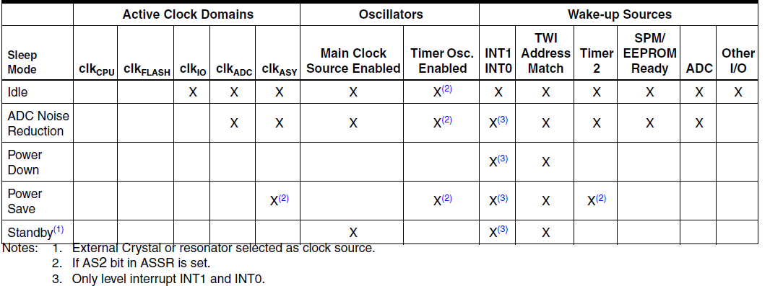

Slide 8
Refer Page number 33 – 35 of data sheet

